Slide 1
OpenCV
Basics with code demo
Prashanga Pokharel, 2022/11/10

Slide 2

Opencv
Introduction
OpenCV stands for Open-Source Computer Vision (Library).
It is the most common and popularly used, well-documented Computer Vision library.
OpenCV is an open-source library that incorporates numerous computer vision algorithms.
OpenCV increases computational efficiency and assists with real-time applications.
One of the major goals of OpenCV is to provide an accessible and easy-to-use computer vision infrastructure that helps people build sophisticated computer vision applications quickly.

Slide 3
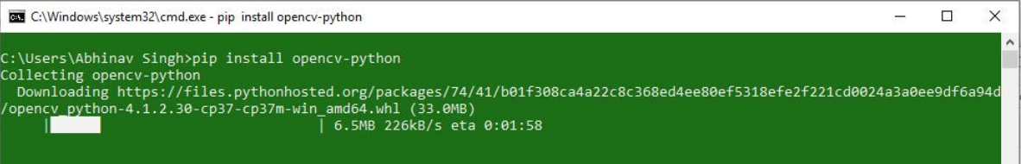
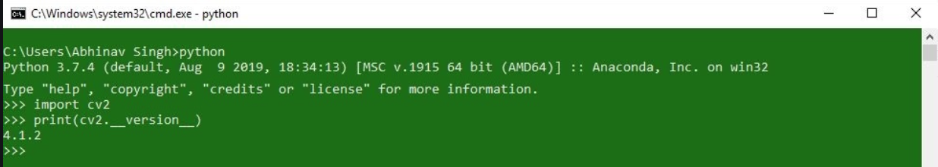
OpenCV installation
For windows system
Requirements: Python and pip
Installation code:
Check if OpenCV is correctly installed:

Slide 4
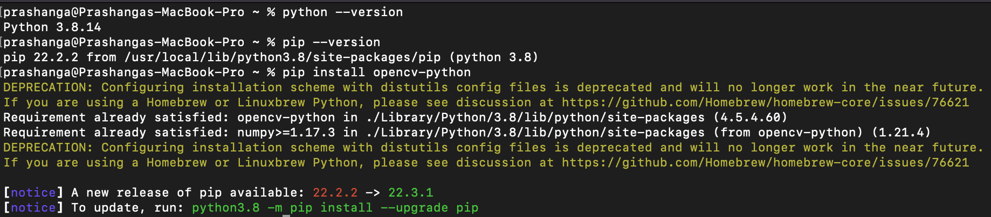
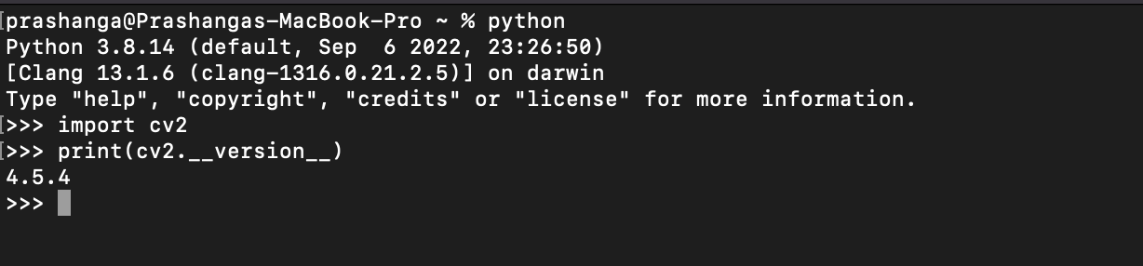
OpenCV installation
For Linux system
Requirements: Python and pip
Installation code:
Check if OpenCV is correctly installed:

Slide 5
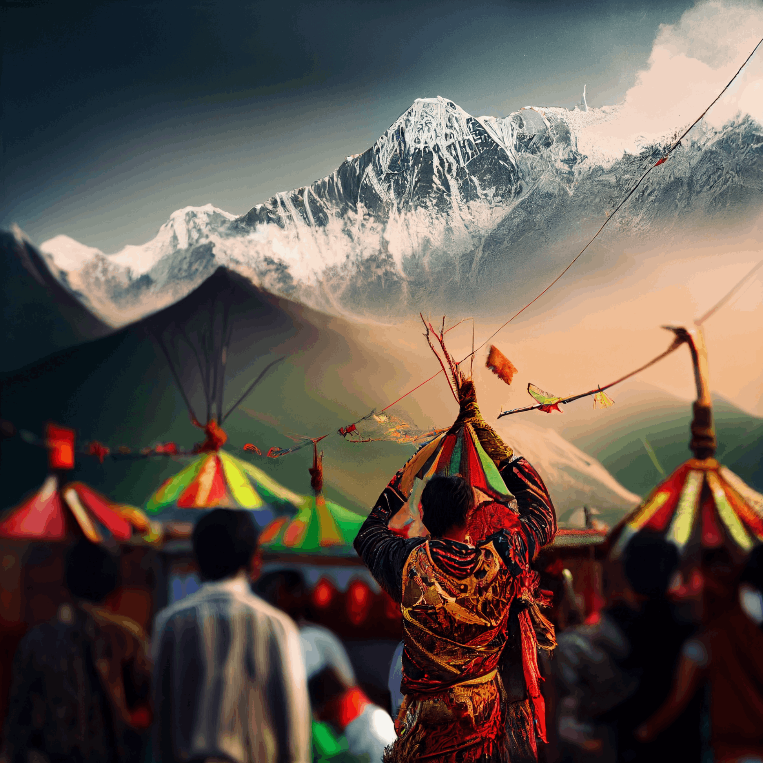
OpenCV for an Image
Image - Basic
Reading an image
Extracting the RGB values of a pixel
Extracting the ROI
Resizing the image
Rotating the image
Drawing a Rectangle
Display text

Slide 6
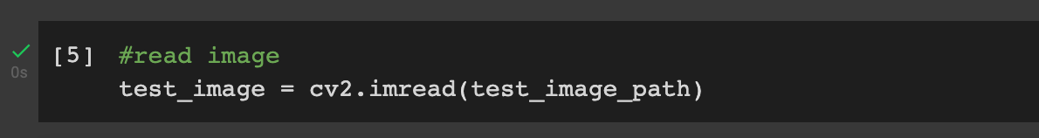
OpenCV
Reading an image
Syntax: cv2.imread(path, flag)
Parameters: path: A string representing the path of the image to be read. flag: It specifies the way in which image should be read. It’s default value is cv2.IMREAD_COLOR
Return Value: This method returns an image that is loaded from the specified file.

Slide 7
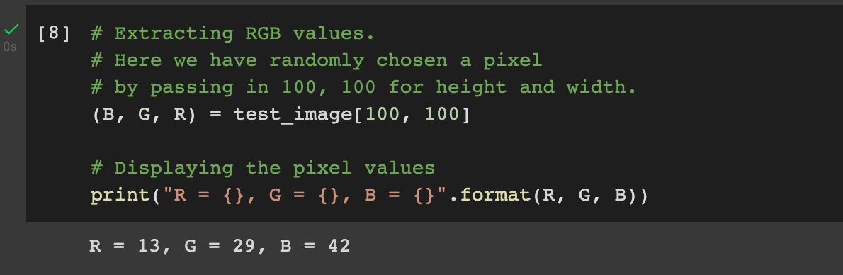
OpenCV
Extracting the RGB values of a pixel
OpenCV can extract the RGB values of an individual pixel.
Note – OpenCV arranges the channels in BGR order. So the 0th value will correspond to Blue pixel and not Red.

Slide 8
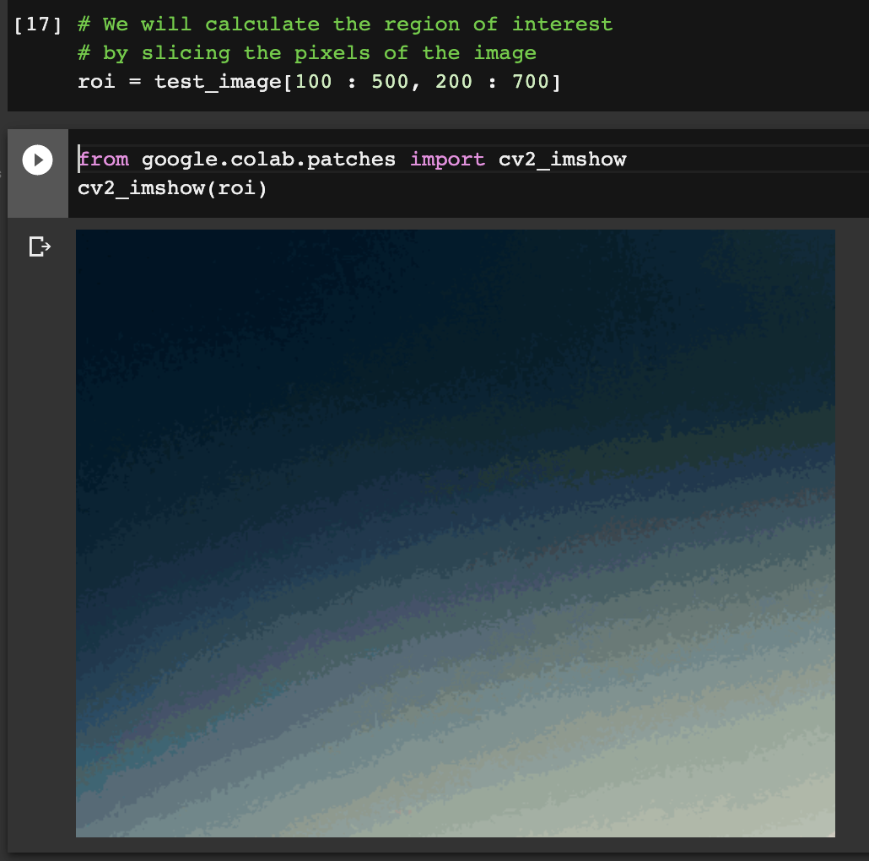
OpenCV
Extracting the ROI

Slide 9
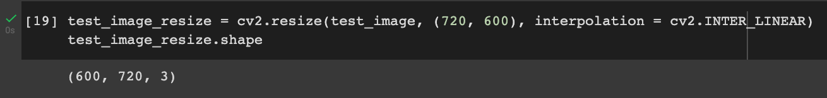
OpenCV
Resizing the Image
Image resizing refers to the scaling of images.
Scaling comes in handy in many image processing as well as machine learning applications.
Choice of Interpolation Method for Resizing:
cv2.INTER_AREA: This is used when we need to shrink an image.
cv2.INTER_CUBIC: This is slow but more efficient.
cv2.INTER_LINEAR: This is primarily used when zooming is required. This is the default interpolation technique in OpenCV.

Slide 10
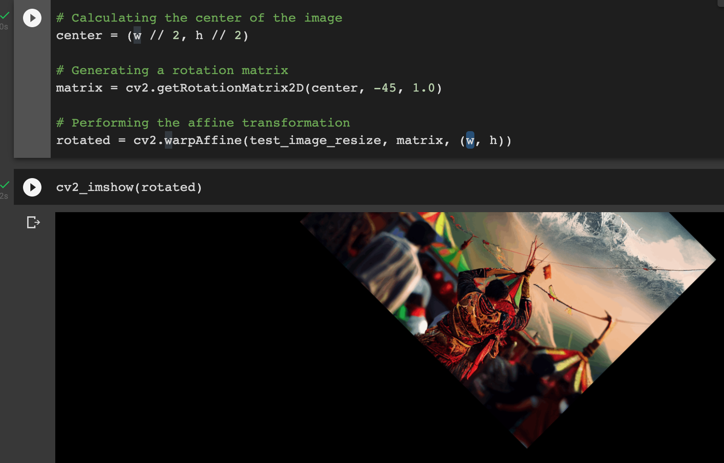
OpenCV
Rotating the image
The 2 main functions used here are –
getRotationMatrix2D()
warpAffine()

Slide 11
OpenCV
Rotating the image
getRotationMatrix2D()
It takes 3 arguments –
center – The center coordinates of the image
Angle – The angle (in degrees) by which the image should be rotated
Scale – The scaling factor
Return: 2×3 Rotation Matrix M
warpAffine()
The function warpAffine transforms the source image using the rotation matrix
It calculates new x, y co-ordinates of the image and transforms it.

Slide 12
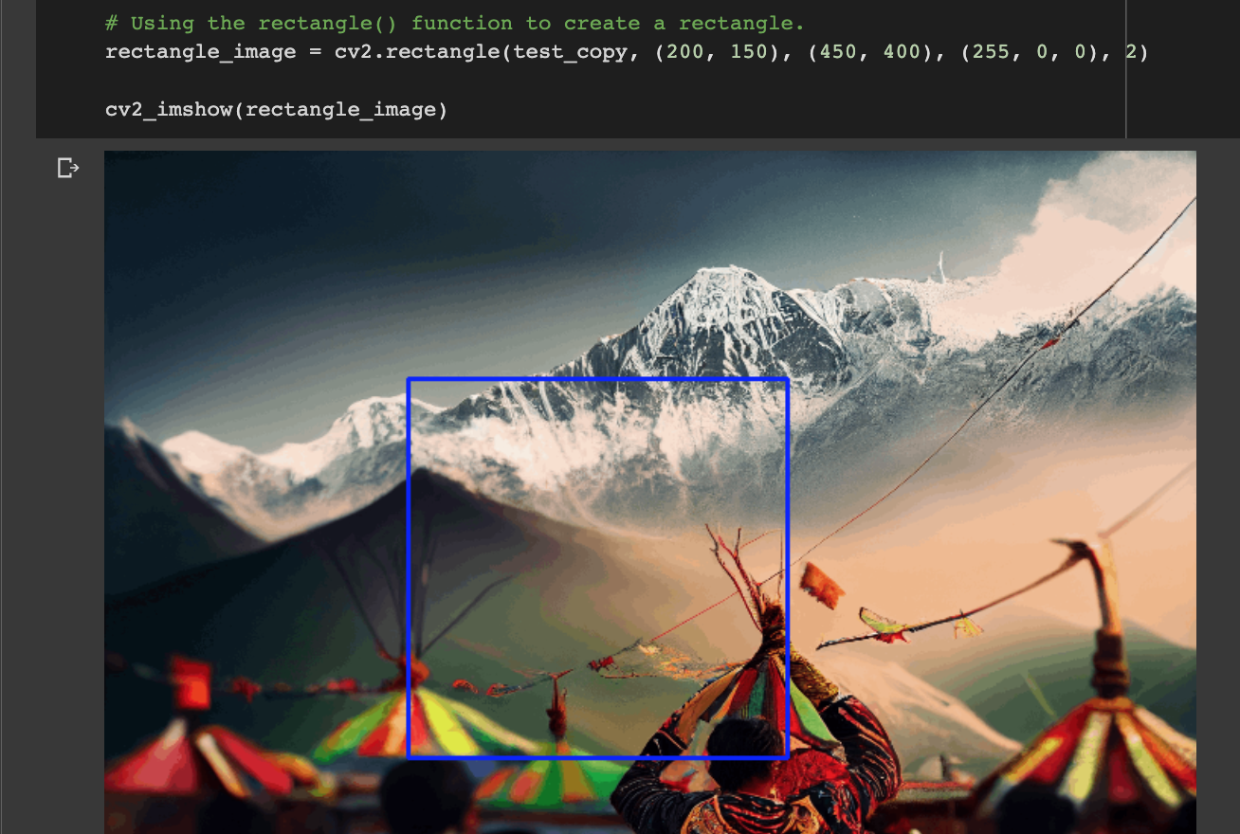
OpenCV
Drawing a rectangle
It takes in 5 arguments –
Image
Top-left corner co-ordinates
Bottom-right corner co-ordinates
Color (in BGR format)
Line width

Slide 13
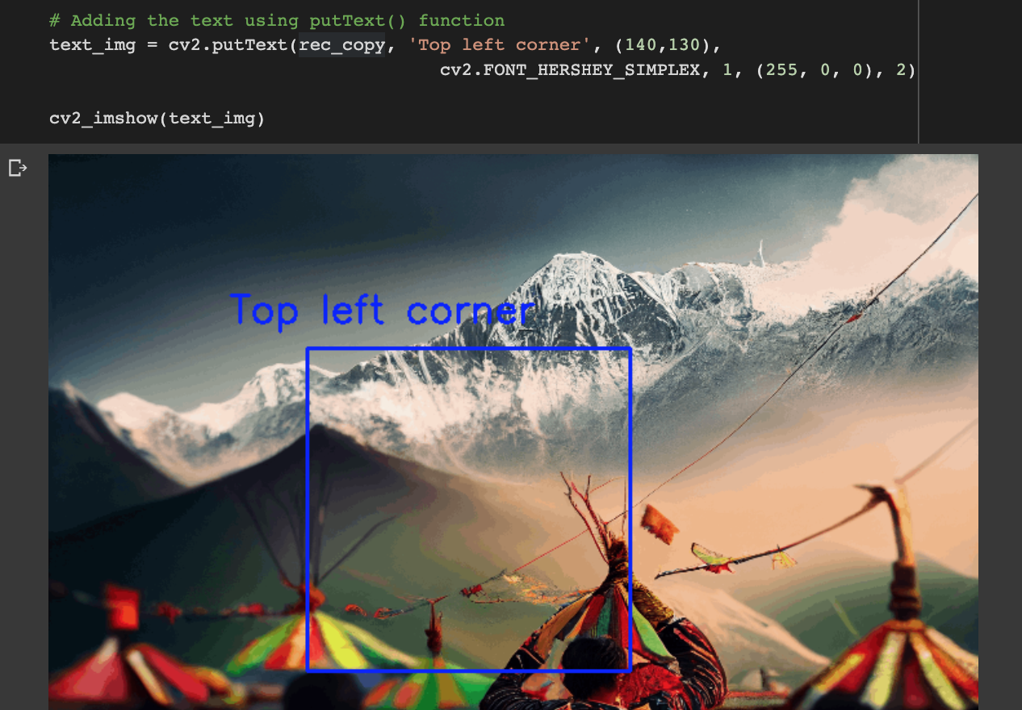
OpenCV
Displaying Text
It takes in 7 arguments –
Image
Text to be displayed
Bottom-left corner co-ordinates, from where the text should start
Font
Font size
Color (BGR format)
Line width

Slide 14
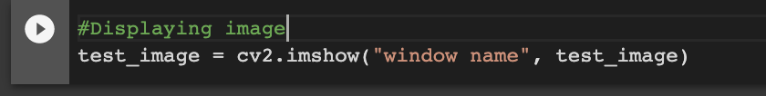
OpenCV
Displaying image
Syntax: cv2.imshow(window_name, image)
Parameters:
window_name: A string representing the name of the window in which image to be displayed.
image: It is the image that is to be displayed.
Return Value: There is no return value.

Slide 15
OpenCV for an Image
Image - Operations
Eroding
Blurring
Erosion and dilation
Simple thresholding
Canny edge detection
Find co-ordinate of contours

Slide 16
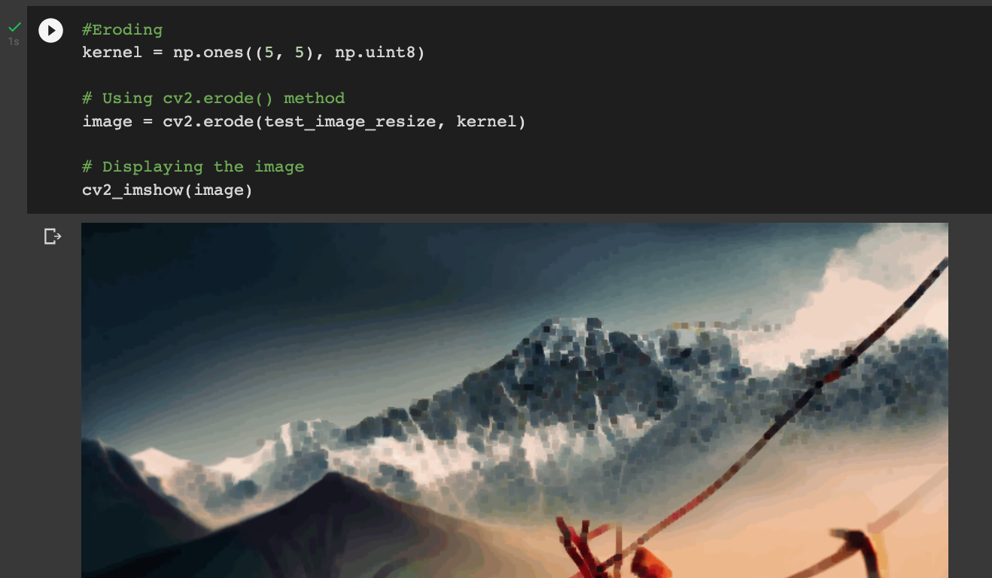
OpenCV
Eroding
cv2.erode()
cv2.erode() method is used to perform erosion on the image.
The basic idea of erosion is just like soil erosion only, it erodes away the boundaries of foreground object.
kernel: A structuring element used for erosion. If element = Mat(), a 3 x 3 rectangular structuring element is used. Kernel can be created using getStructuringElement.

Slide 17
OpenCV
Blurring
Image Blurring refers to making the image less clear or distinct. It is done with the help of various low pass filter kernels.
Different types of blurring:
Gaussian blur
Used to reduce image noise and reduce detail. It is also used as a preprocessing stage before applying our machine learning or deep learning models.
Median Blur
is a non-linear digital filtering technique, often used to remove noise from an image or signal. it preserves edges while removing noise. It is one of the best algorithms to remove Salt and pepper noise.
Bilateral Blur
It replaces the intensity of each pixel with a weighted average of intensity values from nearby pixels.sharp edges are preserved while discarding the weak ones.

Slide 18
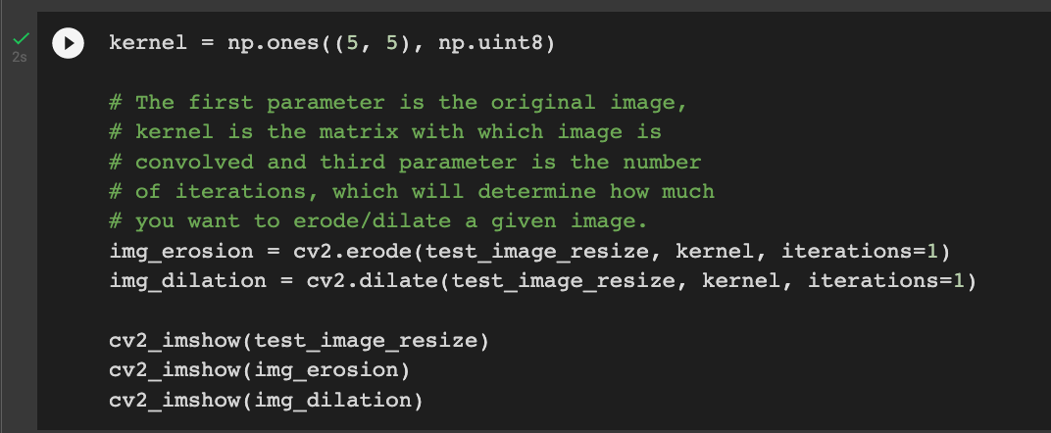
OpenCV
Erosion and Dilation
Uses of Erosion and Dilation:
Erosion:
It is useful for removing small white noises.
Used to detach two connected objects etc.
Dilation:
In cases like noise removal, erosion is followed by dilation. Because, erosion removes white noises, but it also shrinks our object. So we dilate it. Since noise is gone, they won’t come back, but our object area increases.
It is also useful in joining broken parts of an object.

Slide 19
OpenCV
Simple thresholding
Thresholding is a technique in OpenCV, which is the assignment of pixel values in relation to the threshold value provided.
In thresholding, each pixel value is compared with the threshold value. If the pixel value is smaller than the threshold, it is set to 0, otherwise, it is set to a maximum value (generally 255).
Thresholding is a very popular segmentation technique, used for separating an object considered as a foreground from its background.
In Computer Vision, this technique of thresholding is done on grayscale images. So initially, the image has to be converted in grayscale color space.

Slide 20
OpenCV
Simple thresholding
The basic Thresholding technique is Binary Thresholding.
For every pixel, the same threshold value is applied. If the pixel value is smaller than the threshold, it is set to 0, otherwise, it is set to a maximum value.
The different Simple Thresholding Techniques are:
cv2.THRESH_BINARY: If pixel intensity is greater than the set threshold, value set to 255, else set to 0 (black).
cv2.THRESH_BINARY_INV: Inverted or Opposite case of cv2.THRESH_BINARY.
cv.THRESH_TRUNC: If pixel intensity value is greater than threshold, it is truncated to the threshold. The pixel values are set to be the same as the threshold. All other values remain the same.
cv.THRESH_TOZERO: Pixel intensity is set to 0, for all the pixels intensity, less than the threshold value.
cv.THRESH_TOZERO_INV: Inverted or Opposite case of cv2.THRESH_TOZERO.

Slide 21
OpenCV
Simple Thresholding
Syntax:
cv2.threshold(source, thresholdValue, maxVal, thresholdingTechnique)
Parameters:
source: Input Image array (must be in Grayscale).
thresholdValue: Value of Threshold below and above which pixel values will change accordingly.
maxVal: Maximum value that can be assigned to a pixel.
thresholdingTechnique: The type of thresholding to be app

Slide 22
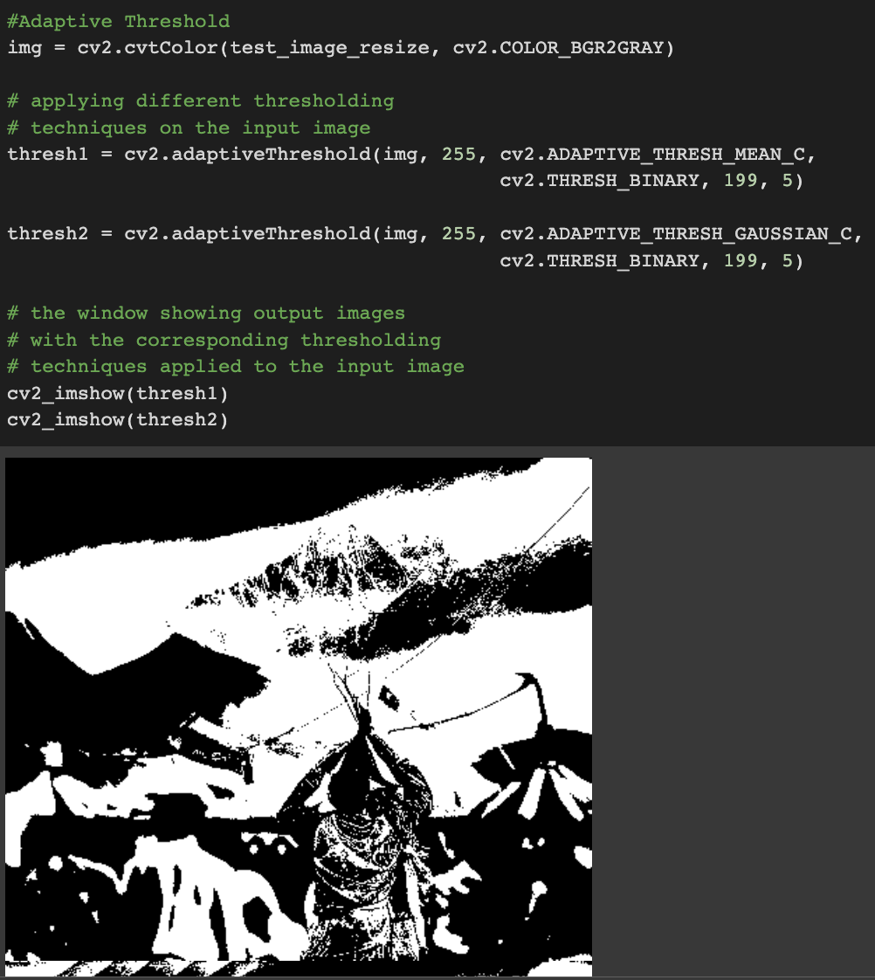
OpenCV
Adaptive thresholding
Adaptive thresholding is the method where the threshold value is calculated for smaller regions.
This leads to different threshold values for different regions with respect to the change in lighting.
We use cv2.adaptiveThreshold for this.

Slide 23
OpenCV
Adaptive Threshold
Syntax: cv2.adaptiveThreshold(source, maxVal, adaptiveMethod, thresholdType, blocksize, constant)
Parameters:
source: Input Image array(Single-channel, 8-bit or floating-point)
maxVal: Maximum value that can be assigned to a pixel.
adaptiveMethod: Adaptive method decides how threshold value is calculated.
cv2.ADAPTIVE_THRESH_MEAN_C: Threshold Value = (Mean of the neighbourhood area values – constant value). In other words, it is the mean of the blockSize×blockSize neighborhood of a point minus constant.
cv2.ADAPTIVE_THRESH_GAUSSIAN_C: Threshold Value = (Gaussian-weighted sum of the neighbourhood values – constant value). In other words, it is a weighted sum of the blockSize×blockSize neighborhood of a point minus constant.
thresholdType: The type of thresholding to be applied.
blockSize: Size of a pixel neighborhood that is used to calculate a threshold value.
constant: A constant value that is subtracted from the mean or weighted sum of the neighbourhood pixels.

Slide 24
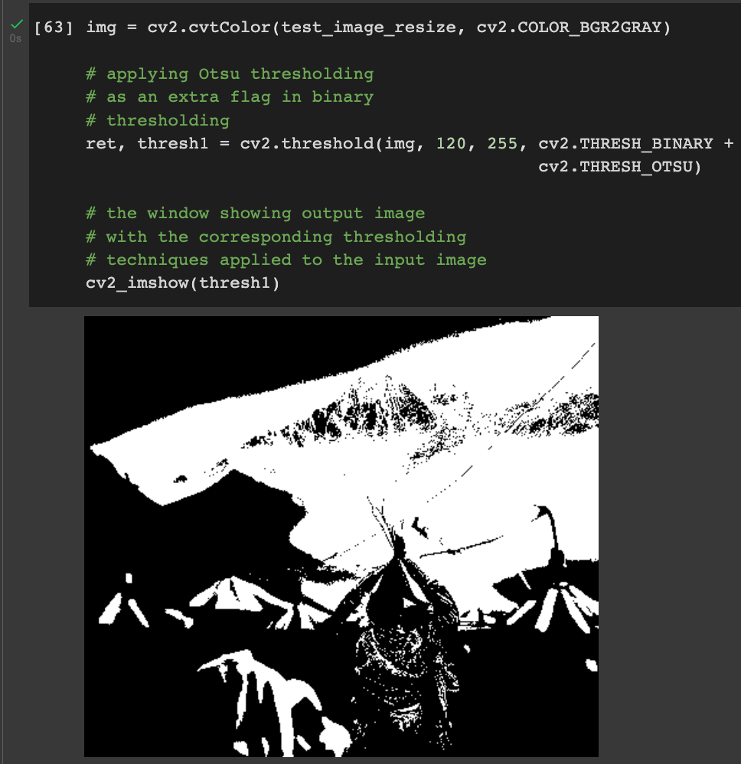
OpenCV
Otsu thresholding
In Otsu Thresholding, a value of the threshold isn’t chosen but is determined automatically.
A bimodal image (two distinct image values) is considered. The histogram generated contains two peaks. So, a generic condition would be to choose a threshold value that lies in the middle of both the histogram peak values.
We use the Traditional cv2.threshold function and use cv2.THRESH_OTSU as an extra flag.

Slide 25
OpenCV
Otsu Threshold
Syntax: cv2.threshold(source, thresholdValue, maxVal, thresholdingTechnique)
Parameters:
source: Input Image array (must be in Grayscale).
thresholdValue: Value of Threshold below and above which pixel values will change accordingly.
maxVal: Maximum value that can be assigned to a pixel.
thresholdingTechnique: The type of thresholding to be applied.

Slide 26
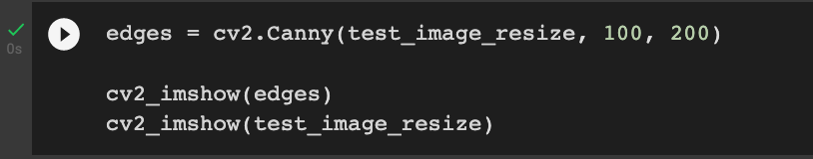
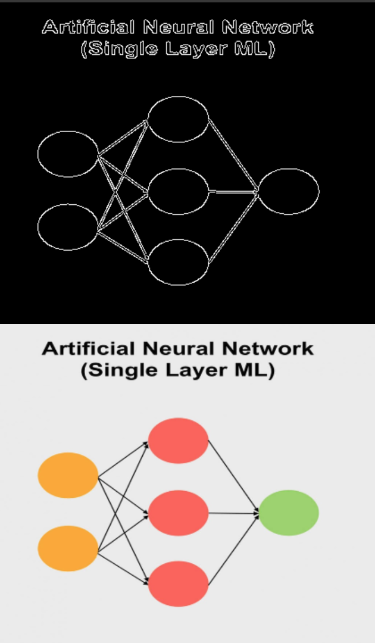
OpenCV
Canny edge detection
In an image, the points where the image brightness changes sharply or has discontinuities are called edges.
Edge detection is a very useful concept and has a variety of applications like classification of objects in the image and localization.
Deep learning models in which there is need of object detection use edge features to extract information about objects present in image. It can also be used for image segmentation and image sharpening.

Slide 27
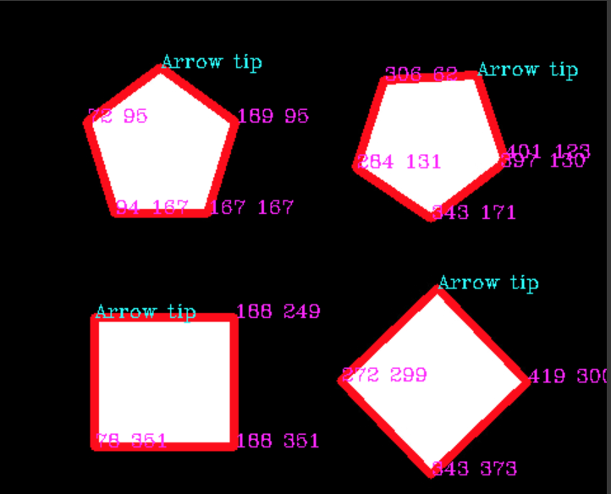
OpenCV
Finding coordinate of Contours
Contours are defined as the line joining all the points along the boundary of an image that are having the same intensity.
Contours come handy in shape analysis, finding the size of the object of interest, and object detection.
we will be using numpy library to convert all the co-ordinates of a contour into a linear array.
This linear array would contain the x and y co-ordinates of each contour.
The key point here is that the first co-ordinate in the array would always be the co-ordinate of the topmost vertex and hence could help in detection of orientation of an image.

Slide 28
OpenCV
OpenCV for video
For webcam:
cv2.VideoCapture(0): Means first camera or webcam.
cv2.VideoCapture(1): Means second camera or webcam.
For saved video:
cv2.VideoCapture("file name.mp4"): Means video file
ret, frames = cap.read()
Each frame is an image in which preprocessing is applied.

Slide 29
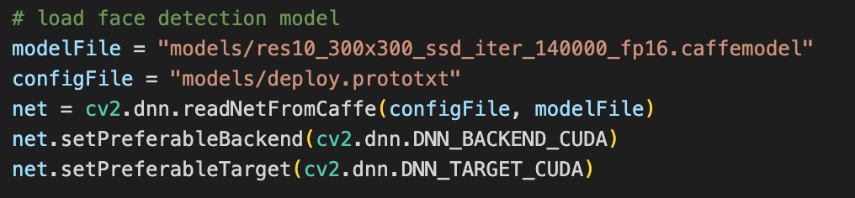
OpenCV
Face blur Using DNN model
Demo python program in which we apply different OpenCV algorithms.
Goal of the project is to blur the face detected using DNN model.
First Step involves model loading.
Model can be downloaded online.

Slide 30
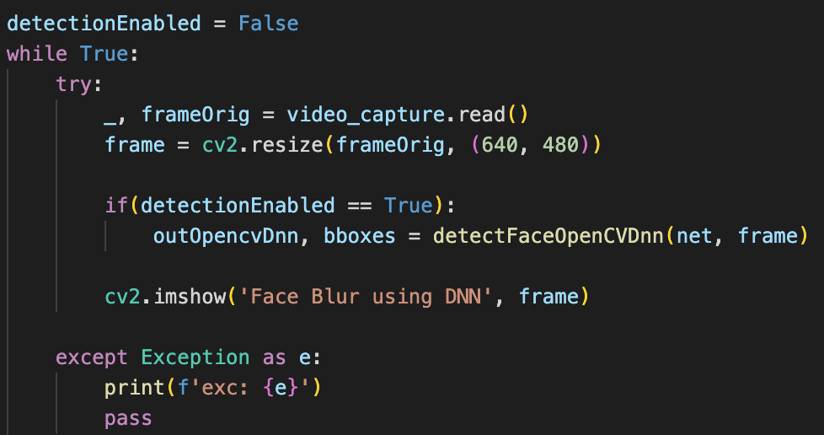
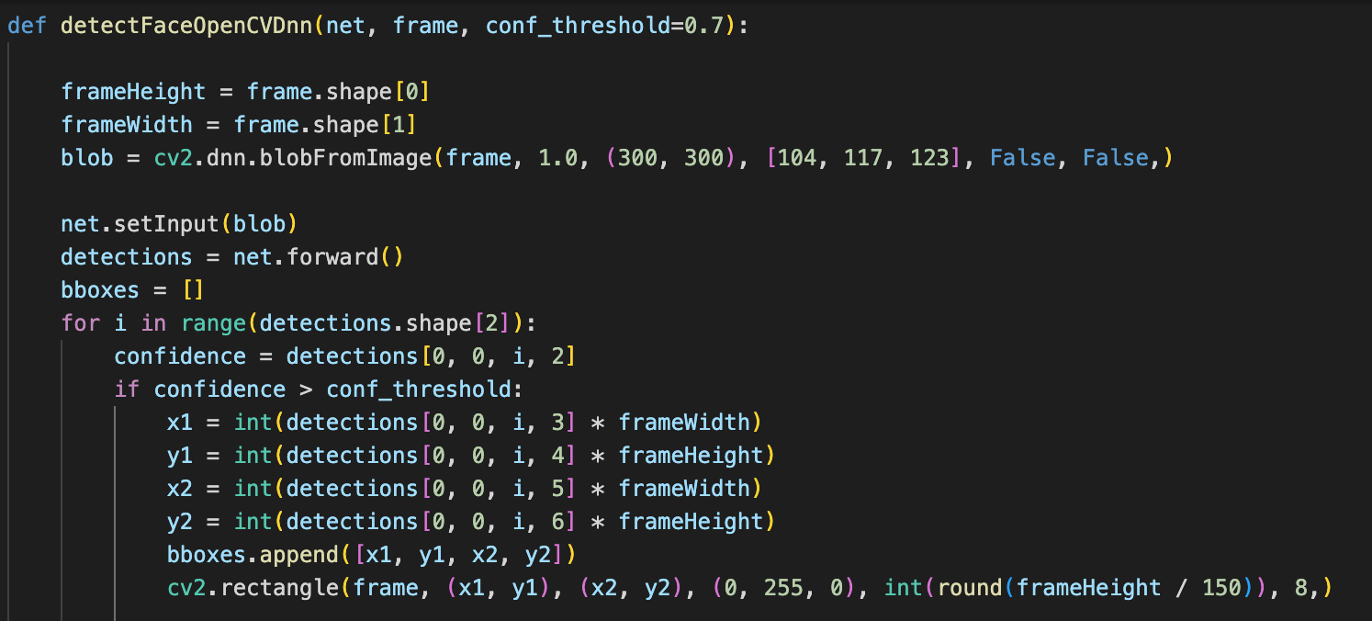
OpenCV
Face blur Using DNN model
2nd step involves Face detection for input image.
Each frame is capture from the video feed of webcam.
DNN model extracts blob from the given image which is then used to draw the bounding box of the face image.
Confidence is used to classify useful and not so useful points for drawing bounding box.
Rectangle is drawing over the bounding box.

Slide 31
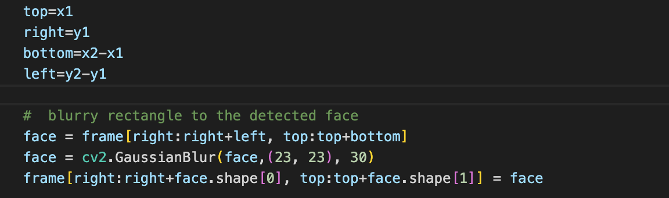
OpenCV
Face blur Using DNN model
Then next step is to blur the face image.
Bounding box coordinate is then converted to face coordinate.
GassianBlur is used for Blur.

Slide 32
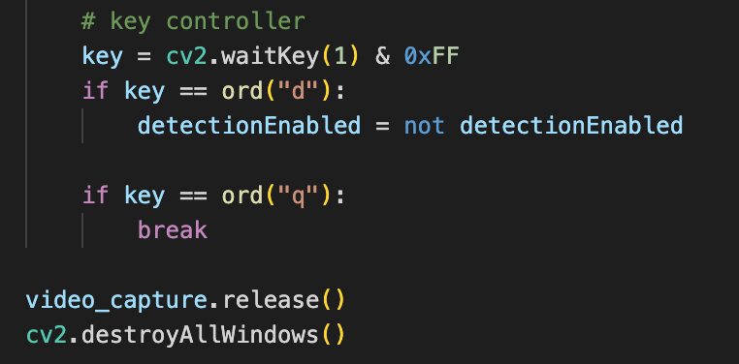
OpenCV
Face blur Using DNN model
Final step is to assign the key controller.
“d” is assign to enable face blur and “q” is assign to end the program.
video_capture.release() is used to release all captured video.
cv2.destroyAllWindows() is used to destroy all the video window.

Slide 33
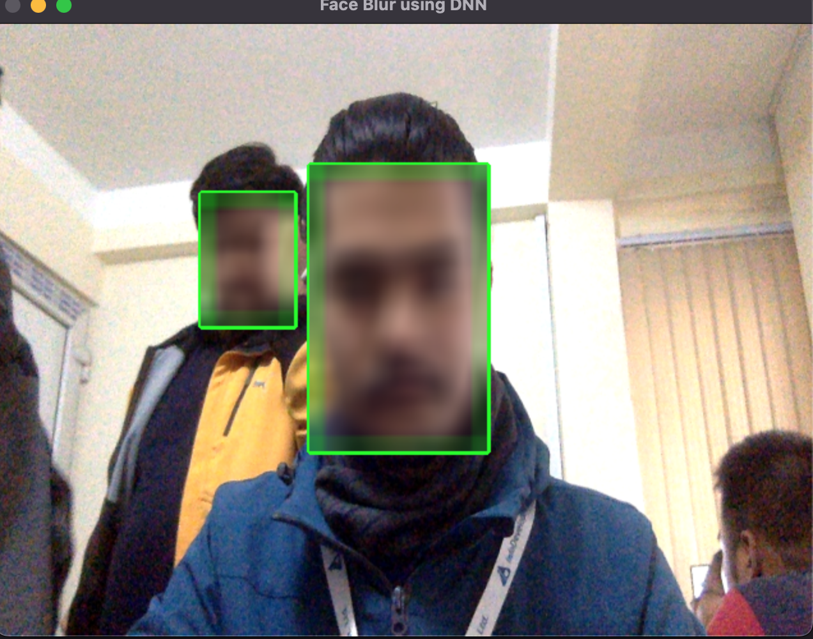
OpenCV
Face blur Using DNN model
Final Result:

